Slide 1
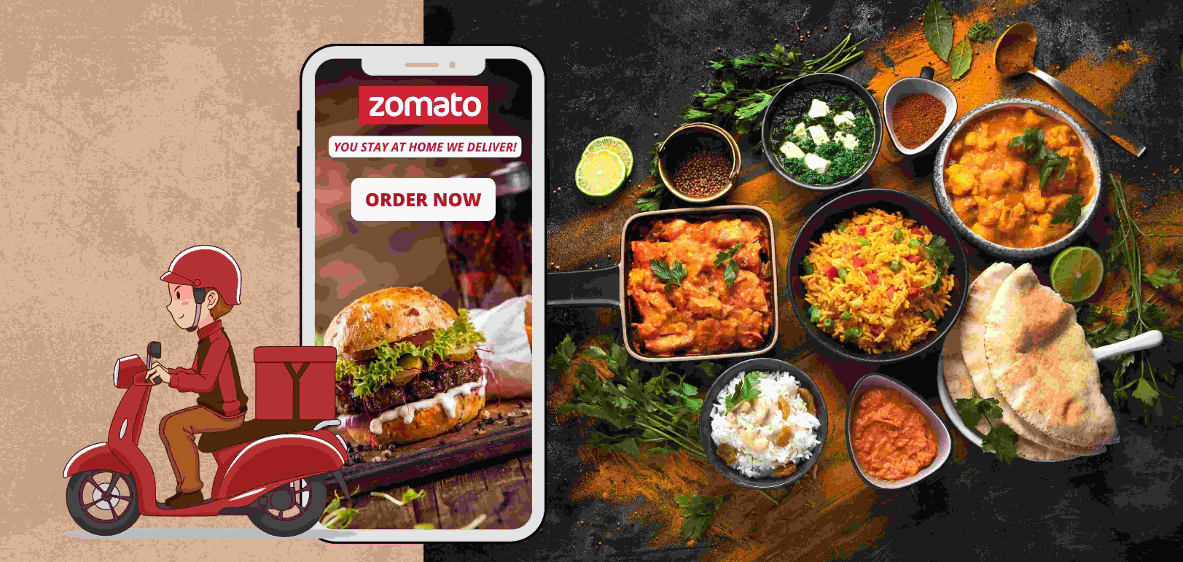
ZOMATA ANALYSIS MYSQL

Slide 2
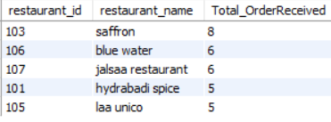
1) Top 5 restaurants Based on No_of_Order Received for October Month

Slide 3
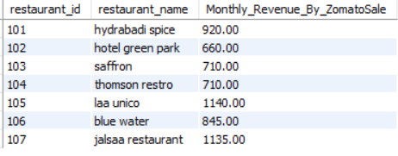
2) Monthly Revenue sales Analysis – Restaurants based

Slide 4

3)Restaurant - Repeated customers & its times of Purchases

Slide 5
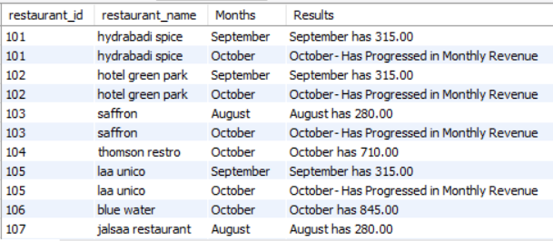
4) Month over Month Analysis of Restaurant sales

Slide 6
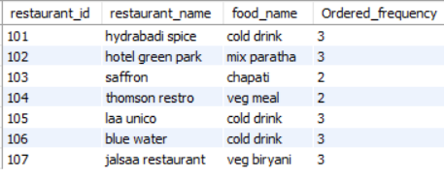
5) Each Restaurants with Most Sold Food item

Slide 7
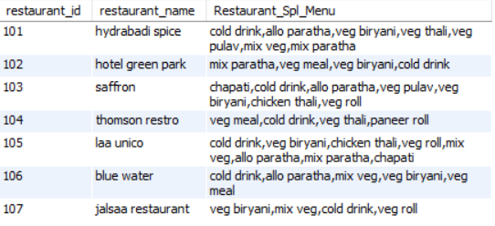
6)Restaurant and its Most Ordered items

Slide 8

7) Count of Customer who registered but never ordered in zomato

